Slide 1
#9. Magnetic Assist
ALL NITERS
Reporter: Jonathan Bruce

Slide 2
Problem Statement
Attach one or two magnets to a non-magnetic and nonconductive base such that they attract a magnet suspended from a string. Investigate how the motion of the moving magnet depends on relevant parameters.
Focus:
How does the moving magnet reach equilibrium?
What are the relevant parameters that affect max speed?
How does the positioning of attached magnets affect motion?

Slide 3
Phenomenon Investigation
[Material Properties, Conceptual Theory]
Theoretical Model
[Mathematical Model, Relevant Parameters]
Experimentation and Discussion
[Setup, Analysis Method, Results, Analysis]
Conclusion

Slide 4
Phenomenon Investigation

Slide 5
Overall motion
A moving magnet is attached to a pendulum, which oscillates back and forth (or doesn’t oscillate, depending on release location)
If it oscillates, it moves just like a pendulum, except it “stutters” or slows down when it gets close to one of the base magnets
Ends up in a more favorable position near a base magnet and oscillates tightly around that spot
If one magnet, it will end up directly on top of the single magnet.

Slide 6
Theoretical Model

Slide 7
Assumptions
Model finding final position:
No kinetic energy when equilibrium reached
Negligent because the moving magnet only vibrates slightly
Pendulum only moves in one plane: plane existing of 2 base magnets and pendulum pivot
That plane must also be perpendicular to the surface
For simplicity
No friction
Negligible because gravity & magnetic forces overpower

Slide 8
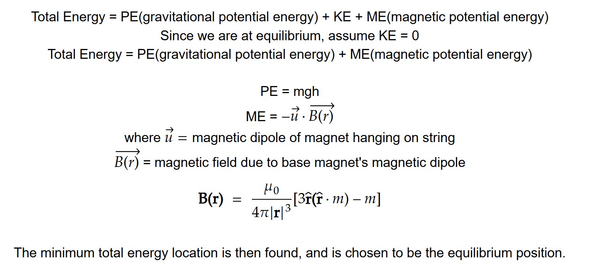
Final equilibrium position derivation
Notes:
https://www.mathcha.io/editor

Slide 9
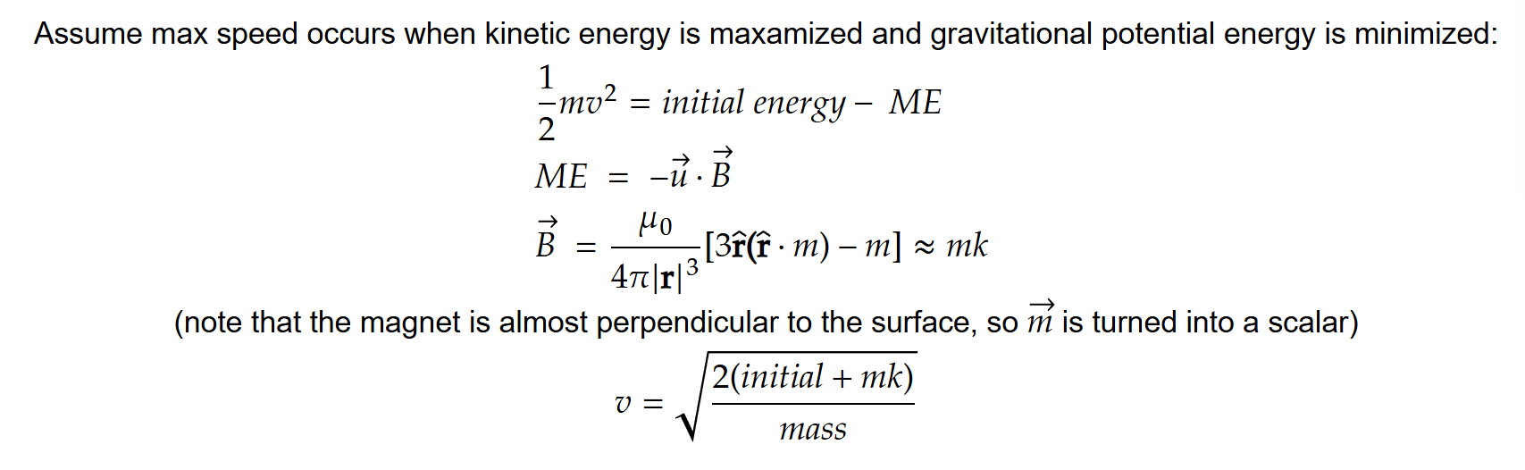
Dipole Strength vs Max Speed relationship derivation
Dipole strength affects how much kinetic energy is left → square root relationship

Slide 10
Experiments and Results

Slide 11
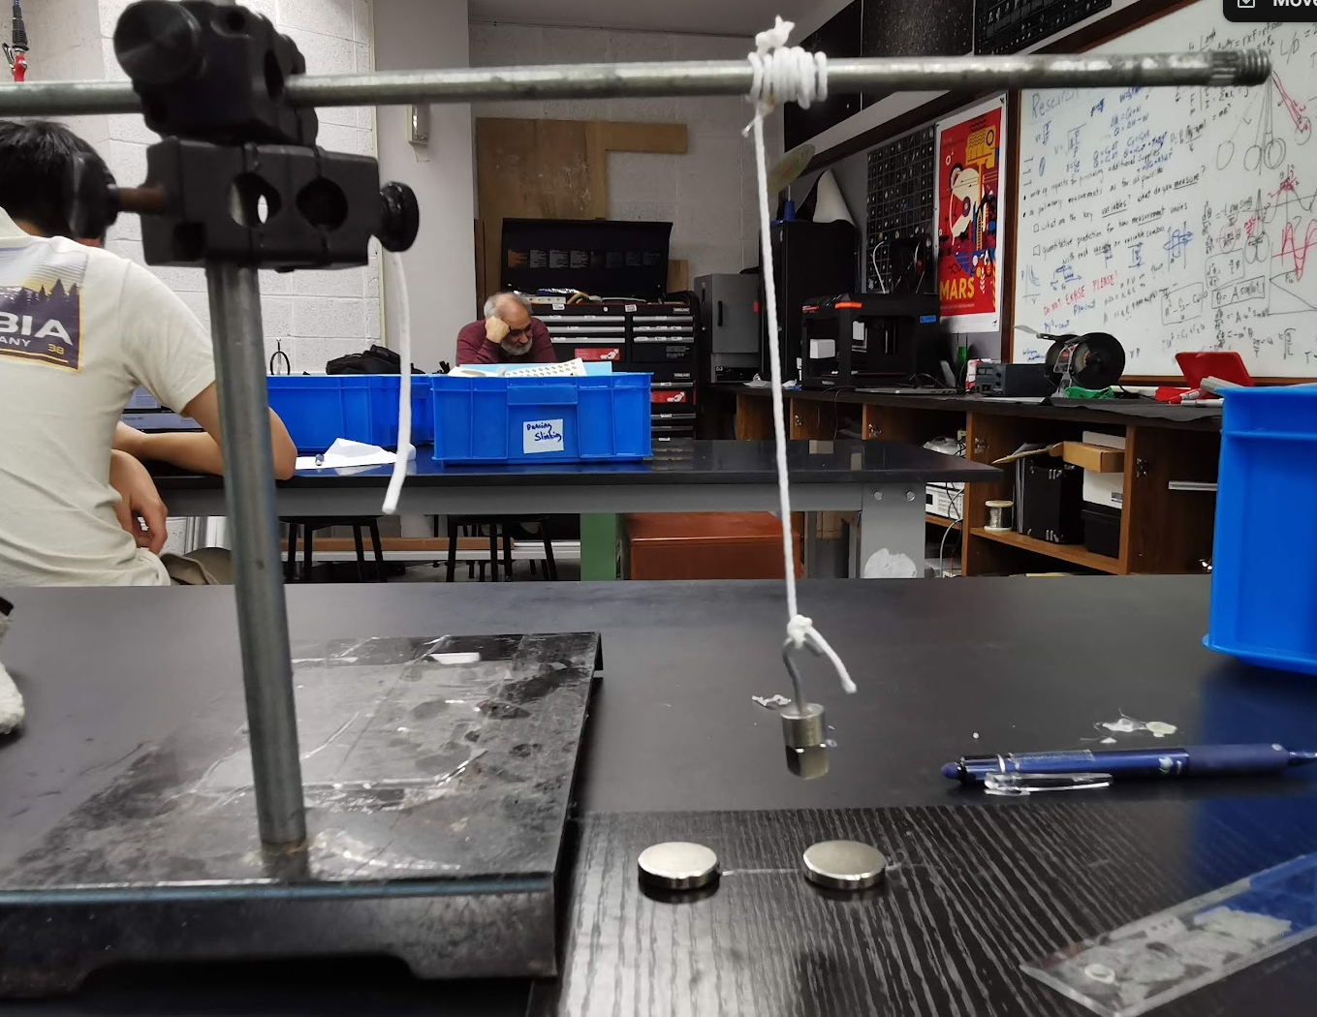
Experimental Setup
Wrapped string to create flexible pivot from single point
Hanging mass
Magnet attached to string
Ensures setup is perpendicular and parallel to the table
Base magnets

Slide 12
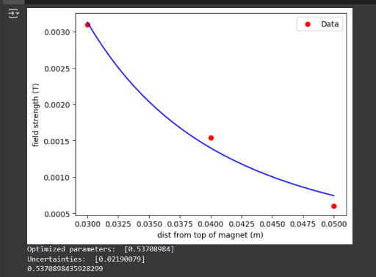
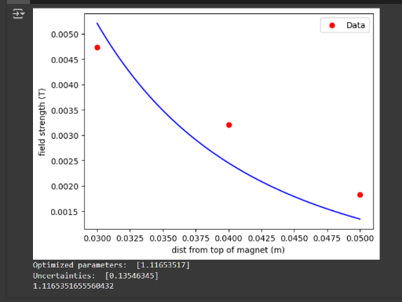
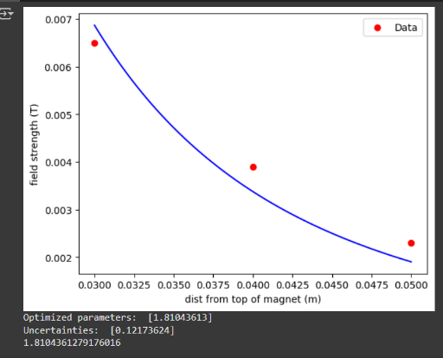
Finding magnetic dipole m of magnets
Using a magnetic field sensor and the magnetic field formula mentioned earlier, we can predict the magnetic dipole moment of the magnets that are used in this experiment.

Slide 13
Experimental Overview
Independent Variables:
In code:
Pendulum mass
String length
Hover height
Dipole moment
Magnet distance from center
Dependent Variables:
Equilibrium position (how far string ends up from center)
Max velocity of pendulum for constant height

Slide 14
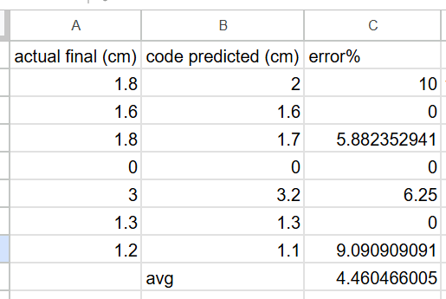
Theory Verification: Equilibrium position

Slide 15
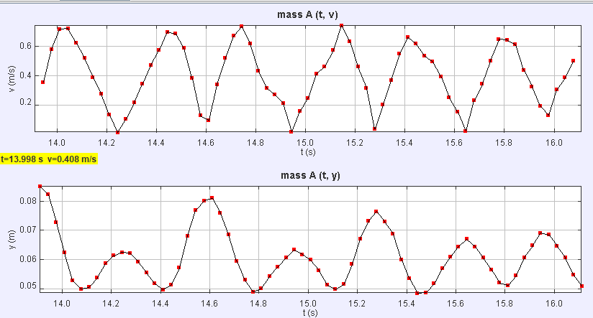
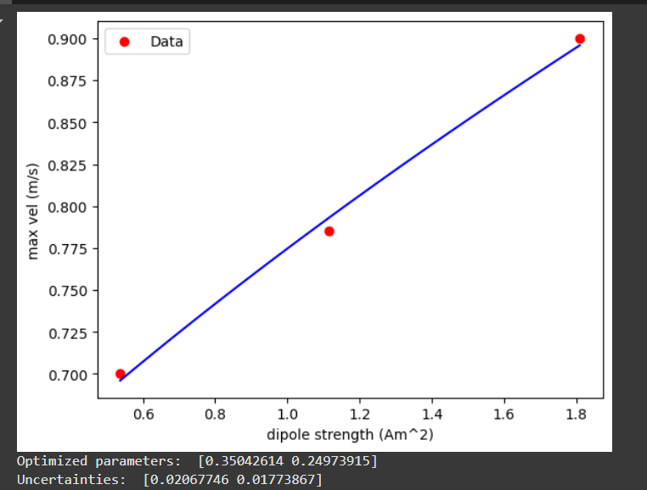
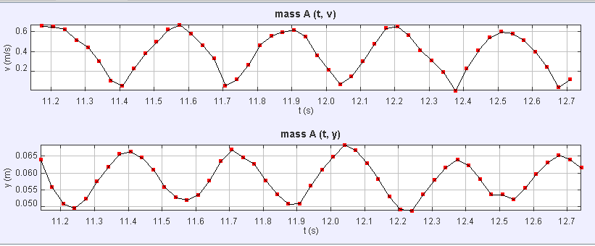
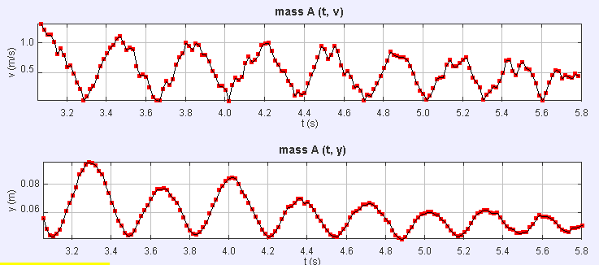

Max velocity of varying dipole strength

Slide 16
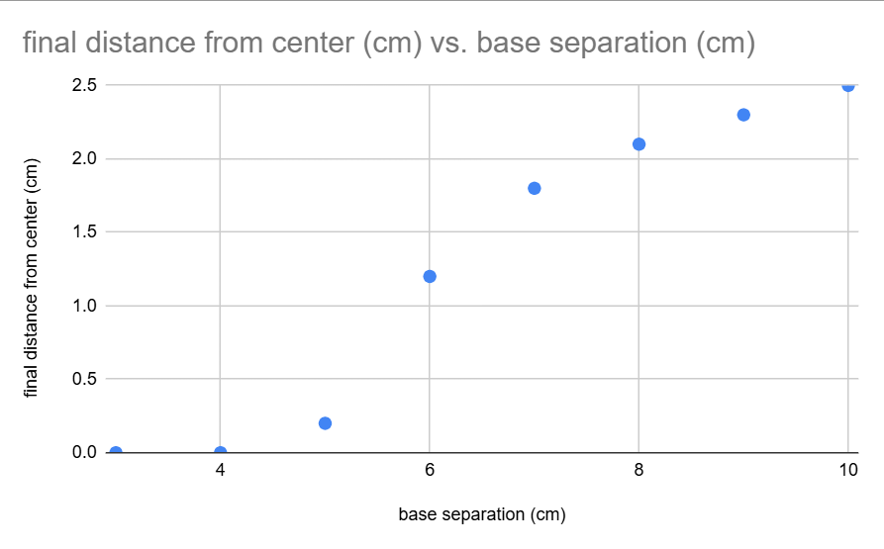
Separation Distance vs Final Distance from center relationship derivation
Greater separation distance = more need for pendulum to deviate from center -> final distance will be further from center
Relationship calculatable from code:

Slide 17
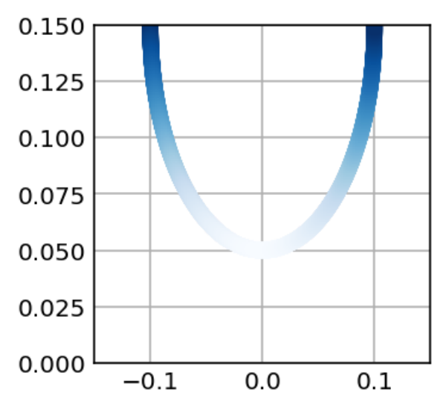
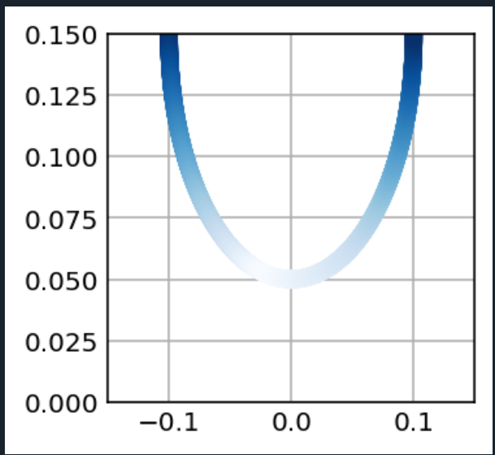
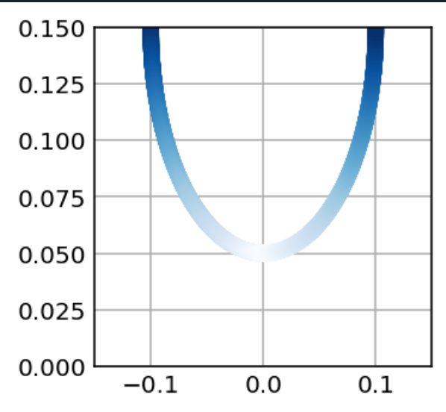
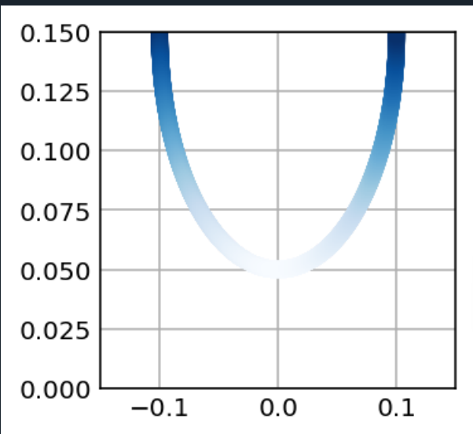
Single magnet equilibrium positions
Base magnet at -0.1
Energy by color graph for single magnet setup with base magnet at -0.035, lighter color = more favorable
Centered magnet at 0
Base magnet at -0.2

Slide 18
Conclusion

Slide 19
Summary
Magnetic dipole gives good estimate on energies and predicts equilibrium position accurately
Motion speed is affected by dipole strength with a square root relationship
Base magnets closer to origin have stronger attraction and therefore more effect on motion of equilibrium
If it’s too close, magnet is unable to oscillate
Errors/room for improvement:
Consider ignored kinetic energy, experiment more configurations, investigate non-continuous motion due to magnetic potential energy

Slide 20
THANK YOU
All Niters

